Slide 1

ElasticSearch for .NET Developers
David Green April 16th 2014

Slide 2
Agenda
Introduction
Setup for Windows
Navigating ElasticSearch using Sense
ElasticSearch demo – Music Store
C# NEST driver (search, facets)
ElasticSearch demo – StackExchange
Advanced topics (fuzzy search, highlighting)

Slide 3

Why ElasticSearch (for me)?
A. D. D => Anger Driven Development

Slide 4
What is ElasticSearch?
NoSQL Database?
Search Engine?
REST API?
???
Wikipedia: ElasticSearch is a search server based on Lucene. It provides a distributed, multitenant-capable full-text search engine with a RESTful web interface and schema-free JSON documents.

Slide 5
Agenda
Introduction
Setup for Windows
Navigating ElasticSearch using Sense
ElasticSearch demo – Music Store
C# NEST driver (search, facets)
ElasticSearch demo – StackExchange
Advanced topics (fuzzy search, highlighting)

Slide 6
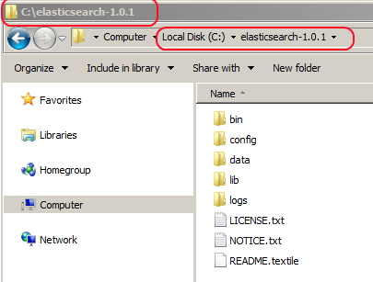
Windows Setup
Go to http://www.elasticsearch.org/download/
Download ZIP file and unzip. I put the contents of the zip file here ➔
Make sure you have JAVA installed on your machine. If not, get it from here and follow the instructions http://java.com/en/download/index.jsp
Notes:
http://www.elasticsearch.org/download/

Slide 7
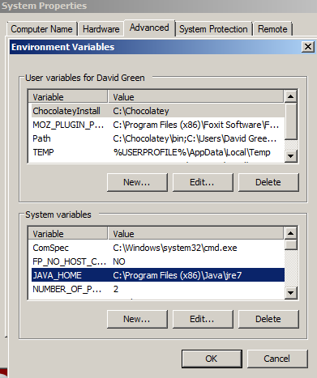
Windows Setup CONT.
4. Set the JAVA_HOME variable to point to your jre7 folder. Right click “My Computer” →Properties → Advanced Settings → System variables Click “New…” button and add the full jre7 folder path.
Notes:
C:\elasticsearch-1.0.1\bin\elasticsearch.bat

Slide 8
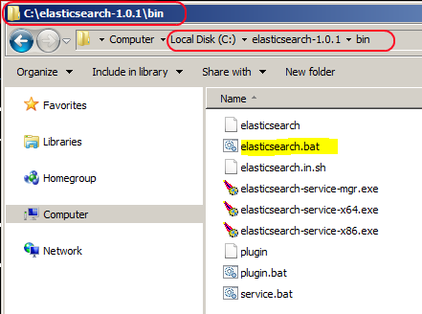
Windows Setup CONT.
5. From Windows Explorer launch: elasticsearch.bat
Notes:
C:\elasticsearch-1.0.1\bin\elasticsearch.bat

Slide 9
Agenda
Introduction
Setup for Windows
Navigating ElasticSearch using Sense
ElasticSearch demo – Music Store
C# NEST driver (search, facets)
ElasticSearch demo – StackExchange
Advanced topics (fuzzy search, highlighting)

Slide 10
Basic ElasticSearch Concepts

Slide 11


Slide 12
Elasticsearch
In ElasticSearch, a Document is the unit of search and index.
An index consists of one or more Documents, and a Document consists of one or more Fields.
In database terminology, a Document corresponds to a table row, and a Field corresponds to a table column.

Slide 13
Indexing
ElasticSearch is able to achieve fast search responses because, instead of searching the text directly, it searches an index instead.
This is like retrieving pages in a book related to a keyword by scanning the index at the back of a book, as opposed to searching every word of every page of the book.
This type of index is called an inverted index, because it inverts a page-centric data structure (page->words) to a keyword-centric data structure (word->pages).

Slide 14
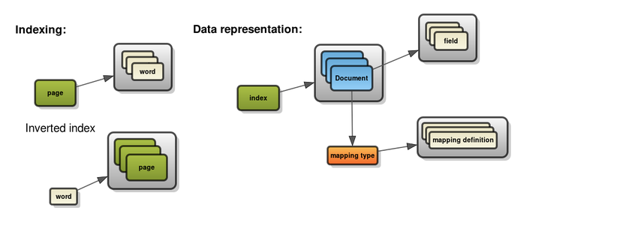
Indexing

Slide 15
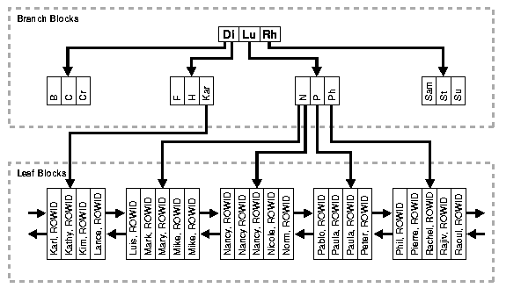
B-Tree indexes

Slide 16
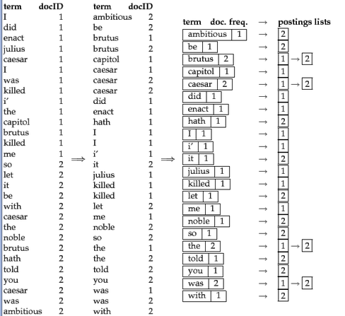
Inverted indexes

Slide 17
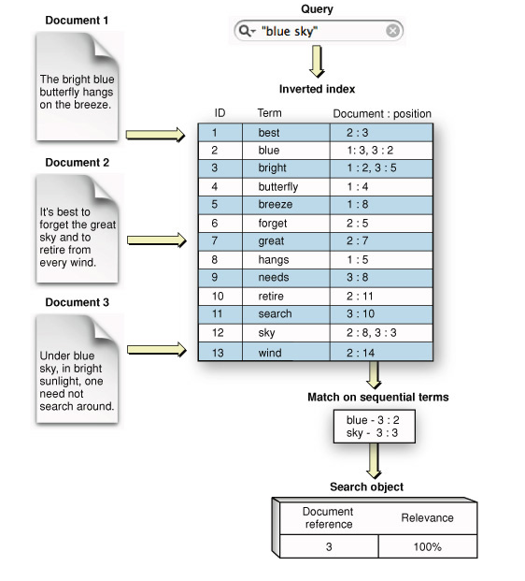
Inverted indexes Example

Slide 18
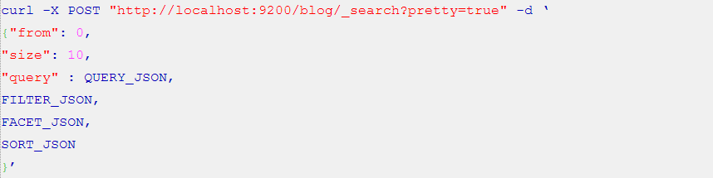
Query DSL
The Query DSL is ElasticSearch's way of making Lucene's query syntax accessible to users, allowing complex queries to be composed using a JSON syntax.
The main structure of a query is roughly:

Slide 19
When To USE ElasticSearch
As a standalone NoSQL document database.
Require certain aggregate computations (facets).
Fast/powerful search capability (Lucene).

Slide 20
Agenda
Introduction
Setup for Windows
Navigating ElasticSearch using Sense
ElasticSearch demo – Music Store
C# NEST driver (search, facets)
ElasticSearch demo – StackExchange
Advanced topics (fuzzy search, highlighting)

Slide 21
MUSIC STORE
SQL Server CE
EF4
MVC 3
Album
1
Artist
1
1
1
Genre

Slide 22
Agenda
Introduction
Setup for Windows
Navigating ElasticSearch using Sense
ElasticSearch demo – Music Store
C# NEST driver (search, facets)
ElasticSearch demo – StackExchange
Advanced topics (fuzzy search, highlighting)

Slide 23
STACKEXCHANGE - COOKING
MongoDB
MVC 5
Post
1
Comments
N
1
N
N
Answers
1

Slide 24
Summary
Elasticsearch:
Easy installation
Awesome search engine
REST/JSON based QSL
NEST (C# Driver):
Strongly typed client
Fluent
Abstraction over Elasticsearch

Slide 25
Books:
Reference materials
http://exploringelasticsearch.com/searching_a_book.html#ch-booksearch
http://shop.oreilly.com/product/0636920028505.do
http://www.manning.com/hinman/

Slide 26
Links:
Reference materials
http://elasticsearch.org
http://nest.azurewebsites.net/
http://joelabrahamsson.com/elasticsearch-101/
http://joelabrahamsson.com/extending-aspnet-mvc-music-store-with-elasticsearch/
http://www.slideshare.net/mastoj/getting-started-with-elasticsearch-and-net
https://archive.org/details/stackexchange
https://github.com/davidjeet/ElasticSearch/

Slide 27
Questions?

Slide 28
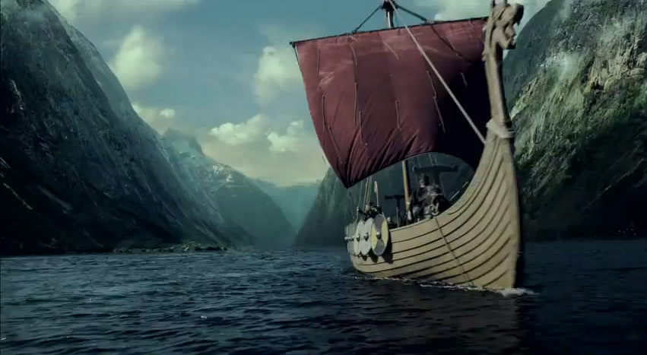
Thank You! @davidjeet

